Slide 1
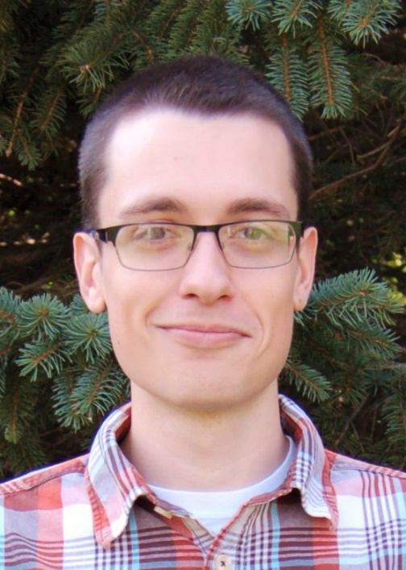
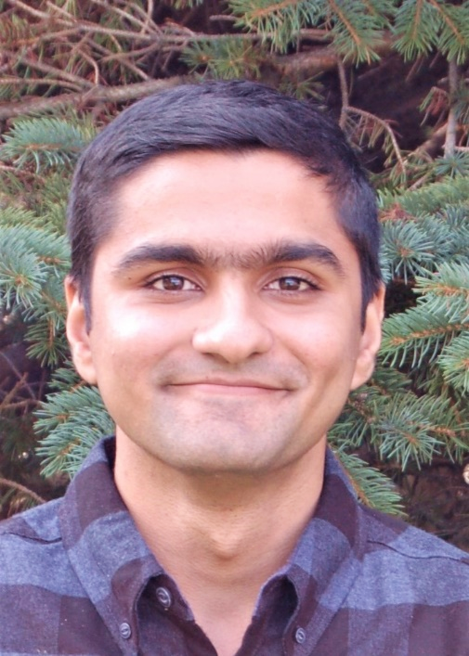
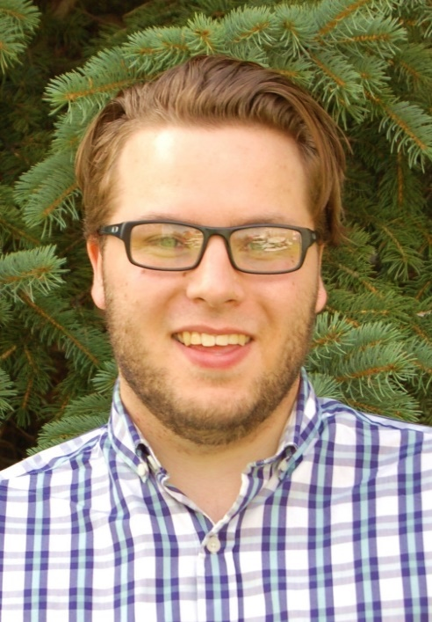
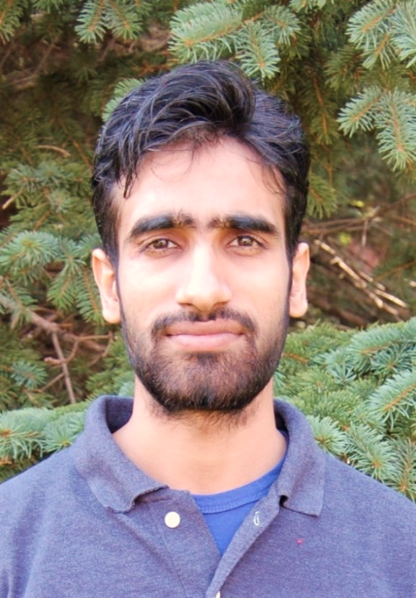
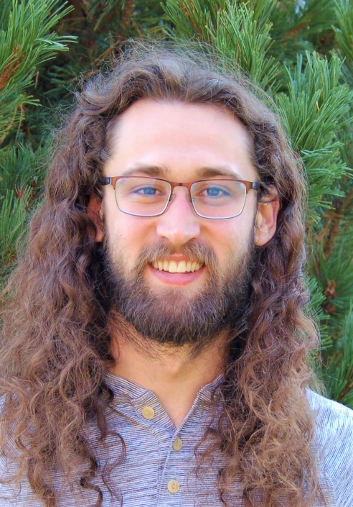
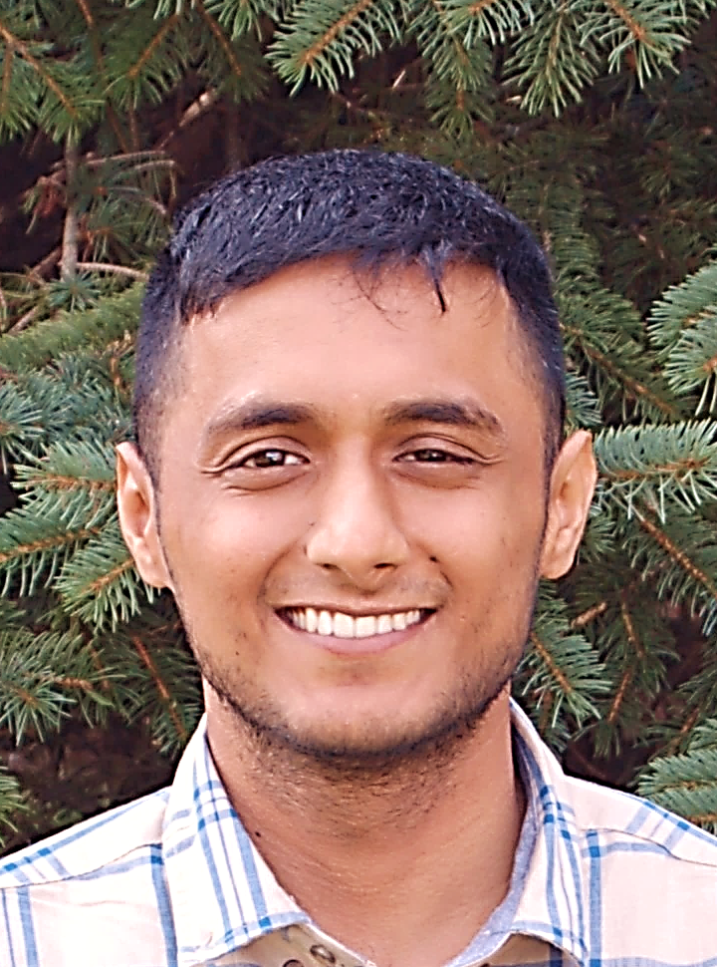
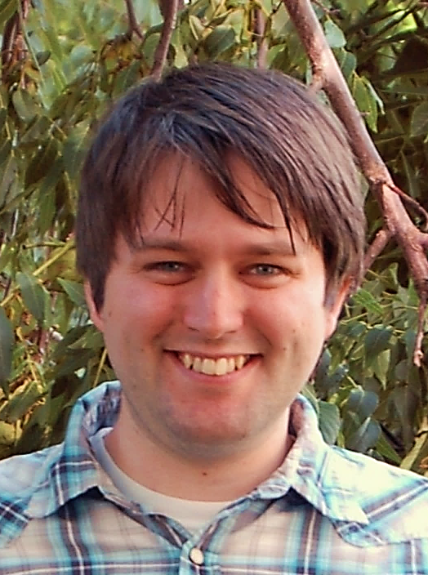
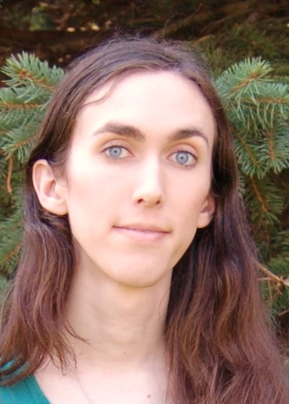
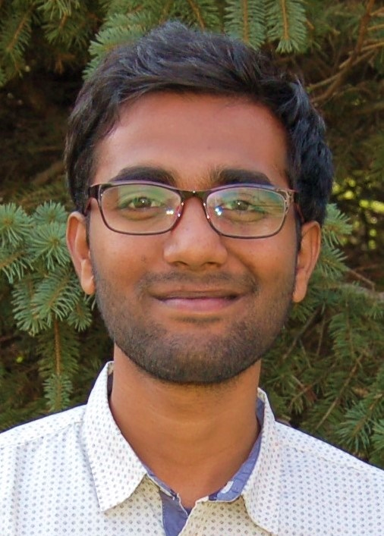
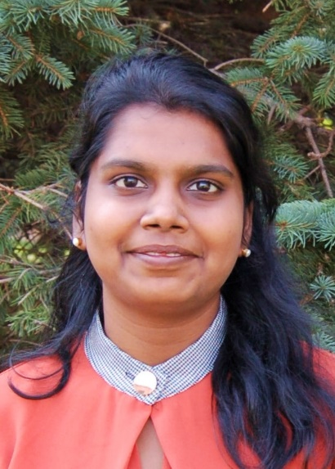
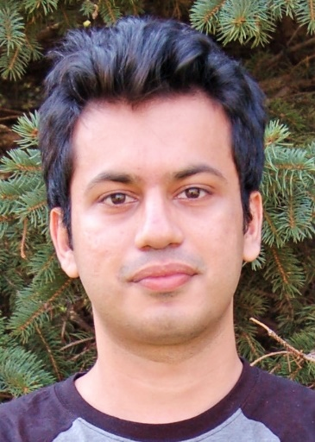
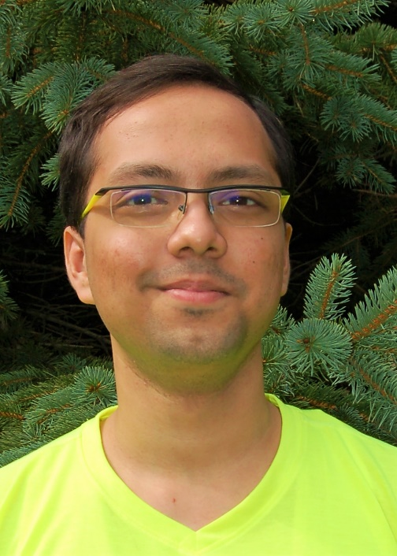
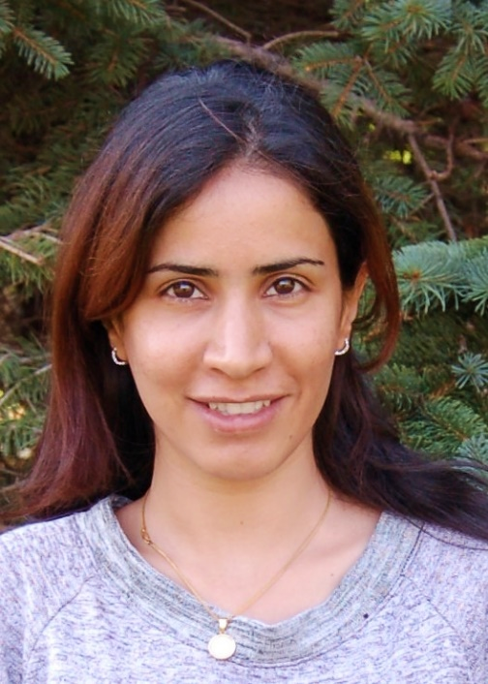
University of Minnesota Duluth
Computer Science Department
2018-2019 Graduate Students
Christianah Adigun
(2nd Yr)
Yumna Anwar
(2nd Yr)
Dale Dowling
(1st Yr)
Usman Gohar
(2nd Yr)
Austin Gordon
(2nd Yr)
Muhammad Gulfam
(1st Yr)
Jackson Houston
(1st Yr)
Mazin Jindeel
(2nd Yr)
Prateek Joshi
(2nd Yr)
Matthew Joyal
(2nd Yr)
Josie Kachelmeier
(1st Yr)
Sai Sumanth Kothapalli
(1st Yr)
Janna Madden
(2nd Yr)
Manaswi Mannem
(1st Yr)
Hamza Mustafa
(1st Yr)
An Thai Nguyen
(2nd Yr)
Zachary Patterson
(2nd Yr)
Aleksandar Straumann
(2nd Yr)
Saptarshi Sengupta
(1st Yr)
Mahsa Soufinyestani
(1st Yr)
Nisarg Thakur
(2nd Yr)
Sagari Vatchavayi
(2nd Yr)
Bo Wen
(2nd Yr)

