Slide 1
Civil Engineering UMD Pre-Advising March 2017

Slide 2
BSCE Admission (Upper Division)
Admission to the upper division B.S.C.E. program requires the following 11 classes with a cumulative GPA of 2.5 or better (and GPA of 2.0 overall)
Chemistry
CHEM 1153 - General Chemistry I (4.0 cr)
CHEM 1154 - General Chemistry Lab I (1.0 cr) or CHEM 1161 - Honors: General Chemistry I (5.0 cr)
Civil Engineering
CE 1025 - Intro to Civil Engineering (1.0 cr)
CE 2017 - Engineering Mechanics and Statics of Materials (5.0 cr)
Computer Science
CS 1121 - Introduction to Programming: Visual BASIC.NET (3.0 cr)
or CS 1411 - Introduction to Programming: Matlab (4.0 cr)
Math
MATH 1296 - Calculus I (5.0 cr) or MATH 1596 - Honors: Calculus I (5.0 cr)
MATH 1297 - Calculus II (5.0 cr) or MATH 1597 - Honors: Calculus II (5.0 cr)
MATH 3280 - Differential Equations w/Linear Algebra (4.0 cr)
Physics
PHYS 2013 - General Physics I (4.0 cr) or PHYS 2017 - Honors: General Physics I (4.0 cr)
PHYS 2014 - General Physics Lab I (1.0 cr)
Writing
WRIT 1120 - College Writing (3.0 cr)

Slide 3
Program Requirements – Spring 2017 or earlier
A grade of C- or better is required in all Civil Engineering courses
BSCE Major Requirements
(41 Credits)
CE 2425 - Geologic Principles* (4 cr)
(*last offered Spring 2016)
CE 3015 - CAD & Engineering Drawing (3 cr)
CE 3016 - Surveying (2 cr)
CE 3025 - Environmental Engineering (3 cr)
CE 3026 - Project Management (3 cr)
CE 3027 - Infrastructure Materials (4 cr)
CE 3115 - Structural Analysis (3 cr)
CE 3221 - Fluid Mechanics (3 cr)
CE 3225 - Hydraulics and Hydrology (4 cr)
CE 3316 - Transportation Engineering (4 cr)
CE 3426 - Soil Mechanics (4 cr)
CE 4255 - Senior Design (4 cr)
Additional BSCE Requirements
(21 Credits)
COMM 1112 - Public Speaking (3 cr)
MATH 3298 - Calculus III (4 cr)
STAT 3411 - Engineering Statistics (3 cr)
PHYS 2015 - General Physics II (4 cr)
PHYS 2016 - General Physics Lab II (1 cr)
WRIT 31xx - Adv Writ (3 cr)
ECON 1022 - Principles of Economics: Macro (3 cr) OR ECON 1023 - Principles of Economics: Micro (3 cr)

Slide 4
Program Requirements - new catalog Fall 2017
A grade of C- or better is required in all Civil Engineering courses
BSCE Major Requirements
(44 Credits)
CE 2020 – Computational Tools (4 cr)
CE 3015 - CAD & Engineering Drawing (3 cr)
CE 3016 - Surveying (2 cr)
CE 3025 - Environmental Engineering (4 cr)
CE 3026 - Project Management (3 cr)
CE 3027 - Infrastructure Materials (4 cr)
CE 3115 - Structural Analysis (3 cr)
CE 3221 - Fluid Mechanics (3 cr)
CE 3225 - Hydraulics and Hydrology (3 cr)
CE 3316 - Transportation Engineering (4 cr)
CE 3426 - Soil Mechanics (4 cr)
CE 4126 - Design of Concrete (3 cr)
CE 4255 - Senior Design (4 cr)
Additional BSCE Requirements
(21 Credits)
COMM 1112 - Public Speaking (3 cr)
MATH 3298 - Calculus III (4 cr)
STAT 3411 - Engineering Statistics (3 cr)
PHYS 2015 - General Physics II (4 cr)
PHYS 2016 - General Physics Lab II (1 cr)
WRIT 31xx - Adv Writ (3 cr)
ECON 1022 - Principles of Economics: Macro (3 cr) or ECON 1023 - Principles of Economics: Micro (3 cr)

Slide 5
Electives
Technical Electives (6 credits):
Any SCSE course above 2xxx (includes CE courses)
Chem 1155 & GIS 3563 also qualify (see catalog for full listing of exceptions)
Civil Engineering Electives (15 credits):
CE 4xxx courses or above
See current catalog for approved list
Take a minimum of 2 CE technical elective courses within a related field, such as geotech, structures, transportation, water resources/environmental
More than 2 courses in one related field can be taken

Slide 6
Liberal Education Requirements
To find courses that count in multiple Lib Ed categories, go to the link below. These courses allow you to stay with the program sample plan. These change often, so make sure you reference this list before registering.
http://www.d.umn.edu/catalogs/current/libed.html

Slide 7
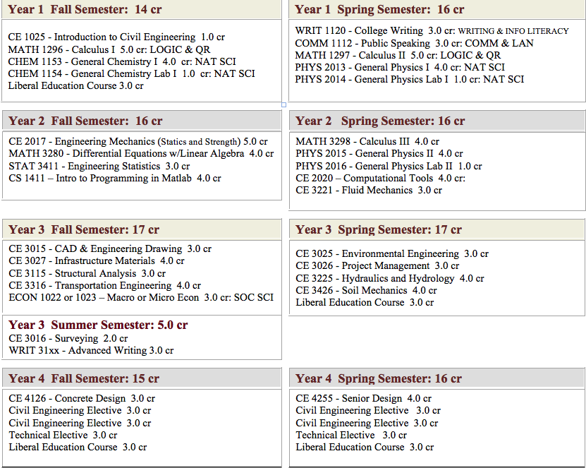
Sample Course Plan
General math & science requirements
Core CE Program requirements
CE & Technical Electives

Slide 8
Freshman/Sophomore Courses
Priority 1: Base Math/Science
Calculus I & II, Chemistry I with lab, Physics I with lab
Diff Eq, Computer Programming
Intro CE course & writing (needed for upper division)
Statistics, Economics, Physics II, Calc III
Priority 2: Mechanics
Engineering Mechanics
Fluid Mechanics
Notes:
Remind them to look at long term sequencing of Mat, Physics, Mechanics, Structures classes or Math, Physics, Mechanics, Fluid Mechanics, water classes.

Slide 9
Upper Division Prerequisites
BSCE (or upper division) prerequisite for CE 3xxx and CE 4xxx courses will be enforced
If you qualify for upper division status now, APPLY FOR UPPER DIVISION prior to advising/registration
The Upper Division form is on the CE website or in CE office
If you are not in upper division because required courses are currently in progress and need to take CE 3xxx courses:
Bring your nearly completed upper division form to your advising meeting
If you can show your advisor that you will be eligible for upper division at the end of the current semester your advisor will put your name on the upper division exception list
Student-specific permission will be given to students listed on the upper division exception list and only for classes listed by your advisor

Slide 10
Surveying (CE 3016)
Offered each May term and each Fall term
The fall section of Surveying usually fills so plan to take the summer section if possible
Internship experience may allow you to waive this course. Academic Petition form with letter from supervisor describing surveying experience should be turned into the CE office for department head review.

Slide 11
Course Changes
CE 2425 Geology for Civil Engineers is no longer being offered. Talk to your advisor about alternatives
CE 4126 Concrete Design is required course in new catalog (Fall 2017)
CE 3025 Environmental Engineering now 4 credits (three 50-minute lectures + lab)
CE 3225 Hydraulics and Hydrology now 3 credits (two 50-minute lectures + lab)
CE 3316 Transportation Engineering changing to lecture only (two 75 minute + one 50 minute lectures)

Slide 12
New Classes – Fall 2017
CE 2020 - Computational Tools for Civil Engineers
10:00-10:50am Mon/Wed/Fri
Lab Sections:
Wed 8:00-9:50am (section 002)
OR Wed 1:00pm-2:50pm (section 003)
Application of engineering computational software to address problems of interest in Civil Engineering. Software to be used in the course: Mathcad, Excel, Matlab, VBA for Excel, Surfer, Grapher & Didger. Problems to be addressed are Civil Engineering applications that involve vector operations, matrix operations, solution of linear and non-linear equations, differentiation, integration, systems of simultaneous linear and non-linear equations, curve fitting, linear and non-linear regression analysis, optimization analysis, basic statistics and probability, random numbers and Monte Carlo analysis and others. These applied mathematical problems will be solved mostly using built-in numerical functions in the software above. For some problems, programming concepts will be covered using Mathcad, Matlab and VBA in Excel. Others topics to be covered include graphing with Grapher and digitizing with Didger and spatial interpolation analysis using Surfer.
Pre-req: CE 1025 and PHYS 2013 or 2017. and MATH 1297 or 1597 (co-req), or instructor consent
CE 4136 – Structural Systems
10:00-10:50am Mon/Wed/Fri
Building codes, design loads, computerized structural analysis and design, gravity and lateral system analysis and design, structural system descriptions and selection considerations, and structural contract documents.
Pre-req: CE 4115, 4126; no grad credit

Slide 13
Senior Design
Take Senior Design in your final semester. All 3xxx courses must be finished before taking Senior Design.
Advisor permission is required to register for Senior Design.

Slide 14
APAS: Key points
Bulletin YR (catalog year)
APAS: Academic Progress Audit Report
Degree Requirements
UMD Catalog
APAS is the official tool used by the registrars office to grant/confer degrees.
APAS is used by students to confirm how courses in progress or completed meet degree requirements: (such as liberal education program, advanced writing and courses in a major/minor).
Students can also use APAS to view remaining credit and course requirements.
Bulletin Yr.: Found at the top right of the generated APAS report.
A student’s Bulletin Yr is determined by the semester they matriculated at UMD
The Bulletin Year coincides with the Catalog requirements for that year. This is aligned with courses required for your major within the catalog for that year.
Departments update requirements each year; therefore, it is important for students to be aware of the requirements for their major.
Talk with you advisor, it may be a benefit to to update to “current requirements”
Notes:
A student’s bulletin year is aligned with the degree/catalog requirements the student is following. APAS is the tool that verifies how the student is meeting or satisfying requirements toward a degree. A Degree is made up of: University Requirements (Liberal Education and Advanced Writing), Major requirements, and possible minor requirements.

Slide 15
Cover your APAS
What is in APAS?
Your Student ID and Bulletin YR
Advisor Name
Service Indicators: Holds
GPA: Cumulative, U of M, Major, and Minor GPA’s
University requirements
Liberal Education requirements
Major and Minor requirements
Important: Review each requirement area in APAS:
The circle graph represents the minimum 120 credits required to graduate; Engineering majors will earn more than 120 credits
The bar graphs represent Lib Ed and Major credits earned.
While graphs are nice, what is most important is reviewing each requirement area within APAS… so “OPEN ALL” to review and look for:
Red and/or a minus (-) indicate and area has not been satisfied
Light Green and (IP) represent a requirement area is in progress
Dark Green and plus (+) represent that area has been satisfied
Notes:
Note: if an area shows a plus+, but there is a highlighted course, the area has been met. Students should also be aware of credits. Example: if a student transferred a course that was 4 credits and UMD’s course is 5, this is a “Transfer credit difference” and can be resolved by submitting an APAS exception form.

Slide 16
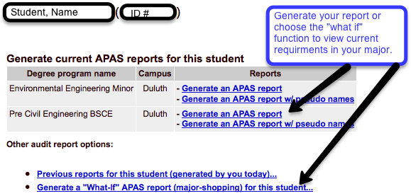
“What If”…APAS
Student can generate a “what if “ report to:
View possible majors or minors not yet declared.
A “what if” report is based on the most current requirements, therefore, students can generate the report to determine if they benefit by updating their Bulletin/Catalog Year.

Slide 17
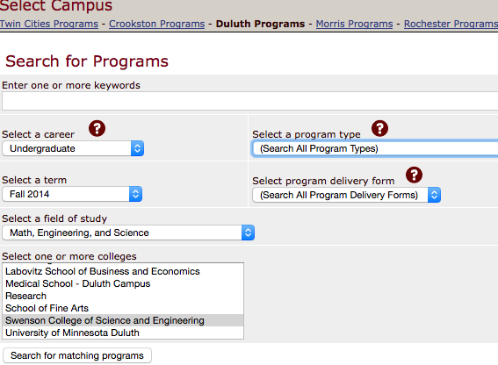
Catalog…know and find yours
The online view of the UMD Catalog is always “current”.
How to search Major requirements in different Catalog Years…
http://www.d.umn.edu/onestop/ UMD Catalog
Undergraduate Majors Search Programs to select criteria:
Notes:
It is important for students to understand the Bulletin Year (catalog year) they are following. This coincides with their APAS view of requirements.
A student can have more than one Bulletin year, examples could be: Major Fall 2014 and Minor Fall 2012.
Look for key changes in different years. Such as course equivalent name and numbering changes. Example: Geol1110= CE3425=CE2435 (F13) =CE2425 (F14) . In this instance an update to current catalog is best. (if not following current catalog, the course might be viewed in Tech Electives and not be applied to the correct area in APAS- this needs to be corrected by using an APAS exception form)
APAS exception forms are available in SCSE Advising Office Engr. 134.

Slide 18
Cover your APAS…
Know the Bulletin Year (catalog year) you are following. It is aligned with Catalog/Major requirements viewed in your APAS.
A student can have more than one Bulletin year, an example could be: Major Fall 2014 and Minor Fall 2012.
Look for key departmental requirement changes in different years.
Such as course equivalent name and numbering changes. Example: Geol1110= CE3425=CE2435 (F13) =CE2425 (F14) . (if not following current catalog, the course might be viewed in Tech Electives and not be applied to the correct area in APAS- this needs to be corrected by updating to current catalog)
Students can request and update to current catalog by submitting an APAS exception form.
APAS exception forms are available in SCSE Advising Office Engr. 134..

Slide 19
Your Advising Meeting
Watch your email for links to Advisor Calendars to schedule your advising meeting
Think about what courses you will be taking and bring your completed planning sheet
Your advisor may not know all the answers, but they will help you find out
Your hold release will be electronically requested at the end of the meeting
Advisors can help guide you, but you are ultimately responsible for ensuring that you meet graduation requirements

Slide 20
When Courses Fill
Get on the waitlist
Auto-enrollment from the waitlist into open seats runs from the first day of open enrollment until the first day of classes.
Watch your email if you are on a waitlist. If the system can not auto enroll you due to schedule conflict or other reason, the next person in line on the waitlist will be enrolled and you will get an e-mail asking you to fix the problem. You will keep your position on the waitlist but will not be enrolled until the conflict is fixed.

Slide 21
Seminar Series
CE Department Seminars:
Scheduled on Friday from 1:00 PM – 1:50 in the High Bay Area approximately every two weeks. Watch for the advertisement. The speaker is selected because they are a professional in the field. There is pizza and beverages at each presentation.
Please feel free to join us, the seminars are presented for your development.

Slide 22
Opportunities to get involved
Undergraduate research
UROP program, 120 hours of research with professor (October and February deadlines)
Student groups
American Concrete Institute
American Society of Civil Engineers
GeoWall
Concrete Canoe
Society of Mining Engineers
Society of Women Engineers
Tau Beta Pi
UMD Veterans Club

Slide 23
Internships/Scholarships
Opportunities are emailed to the Civil Engineering student list, posted on CE website, and listed on GoldPass (through UMD Career Services)
Summer internship tips
Try to do an internship or co-op before you graduate
Remember that you’re representing UMD and the Civil Engineering Department
The Civil Engineering community is tightly knit, so be very careful to not burn bridges (for yourself, future interns, or the department)

Slide 24
Career Fairs
UMD E-Fest Career Fairs in September and February
The Civil Engineering Career Fair is held in February
All CE students (Freshman through Grad students) should plan to attend
Use Career Services resources for preparation
Workshops
Online Handbook
Drop-in help

Slide 25
Graduate Programs
Master of Science
Plan A (with Thesis)
Approximately 2 years after BS
20 course credits , 10 thesis credits
Plan B (Project)
Approximately 1 year after BS
24 course credits , 3 project prep credits , 3 project credits
Integrated MS (IUG Program)
Early admit to MS Plan B program with ability to double count up to 9 credits in both your BS & MS
3.35/4.00 GPA required for IUG option
Speak with your advisor, Dr. Carlos Carranza-Torres (Director of Graduate Studies), and other professors EARLY if you are considering an MS degree

Slide 26
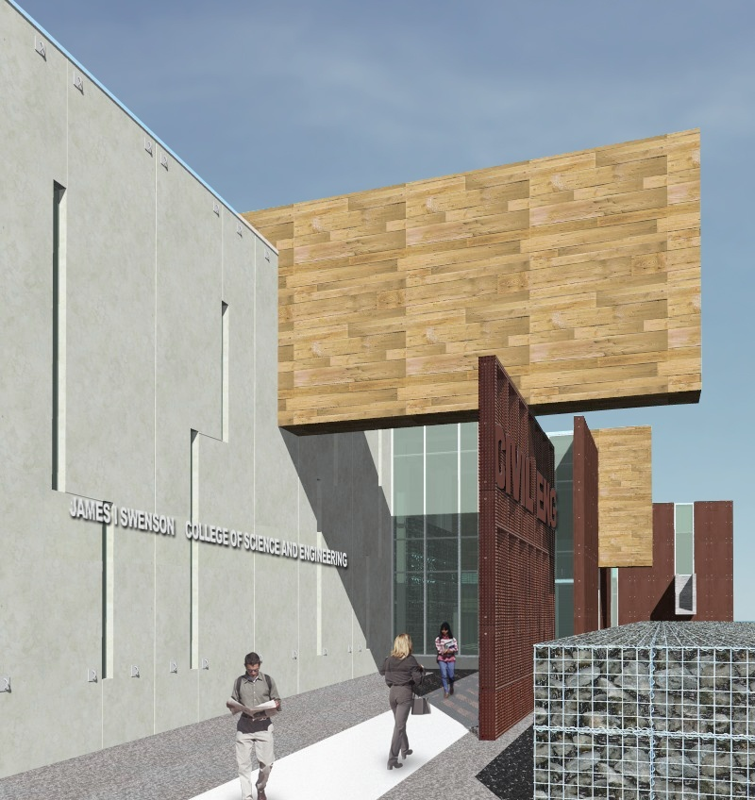
Questions?

